Slide 1

Job Ad Analysis Demo
By Will McFarland
Notes:
Welcome to the demo of my project! To give a quick introduction: the goal of this project is to scrape over 10'000 jobs to and apply Natural Language Processing functions to extract skill phrases from the text. We will search for 2 job titles and look at what the most common skills are for those jobs as well as compare how similar or different the required skills for the different job titles are.

Slide 2
Introduction
Job titles:
Manager
Software Developer
Location:
Vancouver
Notes:
For my project, I chose to look at 'Software Developer' and 'Manager'. To me, these both seem like somewhat broad titles, and I would expect them to have a moderate overlap of skills. I chose Vancouver as my location as that is my home city and there are no shortage of job postings for either of my chosen titles there.

Slide 3
Program Flow
3 Components:
Scraper
Pre-Processing
Natural Language Processing
Notes:
There are 3 main steps to this project:
Scraper, which generates Indeed search URLs and scrapes job ad content.
Pre-Processing: Cleans up the text that we scraped and prepares it for the analysis step.
3. NLP: The Natural Language Processing Functions, which are the core of this project. We want to process our job ads and extract the skill phrases for each job ad.

Slide 4
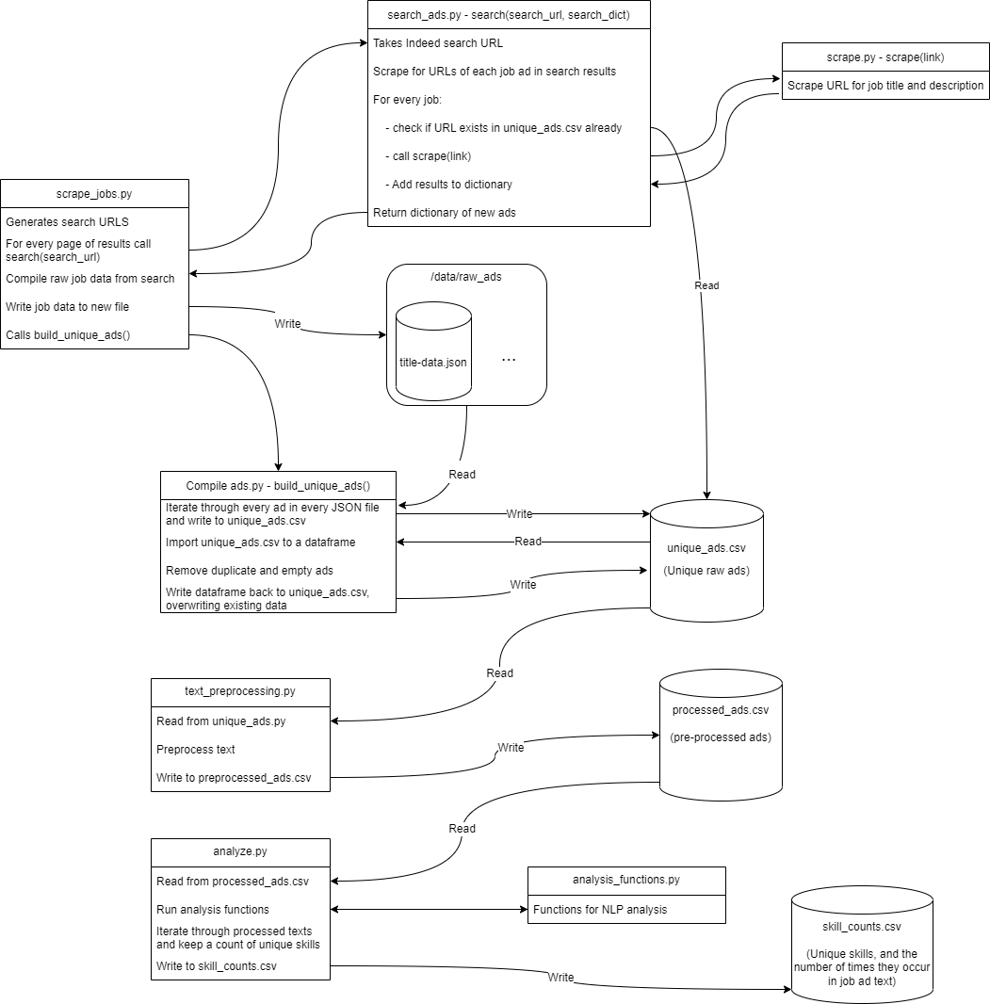
Notes:
These steps can be further broken down in the following flowchart that shows more clearly the inputs and outputs of each step. For the purposes of this demo, I won’t go into great detail, but we will take a brief look at the 3 main steps we highlighted already.

Slide 5
Scraper
Notes:
The first part I will demo is the scraper. Before I do the demo however, it is important to understand what the code is doing.
First, the scraper must generate the search URLs that we are interested in. This includes configurable parameters for the job title, location, and how many results we want to get (Indeed limits search results to 1000). Next, we pass those URLs to the search_ads script that iterates through each ad in the result page and checks if the result already exists in our data. If not, it sends the URL to the scraper to download the job ad and store it in a dictionary that is passed back up the call stack. After all results have been searched or an exception is raised, a new raw JSON file is written to the data directory. Finally, the script compiles all raw files and writes them to a single CSV file called unique_ads, which will contain the URL, job title, and job description for every ad we have scraped.
Now its time to see this step in action!

Slide 6
Pre-Processing
Notes:
The second step is pre-processing the job ads that we just collected. For the analysis step to work as best as it can, we want to provide simple text with no unnecessary punctuation or symbols. For more details on what exactly the pre-processing script does, you can look at the comments in the text_preprocessing.py file.

Slide 7
Natural Language Processing - Analysis
Notes:
The Natural Language Processing Functions are the core of this project. We want to process our job ads and extract the skill phrases for each job ad. The primary output of this step will be a CSV file with columns for the skill phrase, the job title, and the number of times that skill phrase appeared in job ads for each title.

Slide 8
Defining Skills
3 syntactic patterns for skills:
Noun phrase (e.g., Java, ability to work independently, university degree, written communication)
Verb phrase (e.g., develop web application, design software)
Noun + Gerund (e.g., problem solving, web programming)
Notes:
Before I demo the analysis functions, it is important to understand how I defined skills for this project. From the case study we looked at in class, we can use the following 3 syntactic patterns to define skills.
Again, note that for more details on all of these steps, please see my report as this demo is focussing more on the code than the theory in my project.

Slide 9
Identifying Skills – NLP Step
POS Tagging
Chunking
Lemmatization
Notes:
My process is centered around Natural Language Toolkit (NLTK) Part-of-speech (POS) Tagging: we can use it to tag phrases as what part of speech they are (noun, verb, etc.). From the tagged text, we can extract the syntactic skill patterns from the text to identify skills.
After the text has been tagged, we use another function called chunking, which identifies our skill patterns that we defined above.
After tagging and chunking, we finally pass the matching chunks to be lemmatized. This will combine many similar results that are linguistically equivalent.

